Slide 1

Supriya Naik
2/24/2014

Slide 2
Geographical penetration and product mix Analysis
Approach:
- On 2/14 request received from Bob O’Connor, Database Marketer, 2-wheels INC to build a summary, giving by US postal code (1)The number of distinct buyers, (2) The average order value, (3) The total revenue, (4) The most popular product category (the top level in the product hierarchy)
- Performed SQL queries on AdventureWorks2008R2 and AdventureWorksDW2008R2
database to retrieve data for Geographical penetration and product mix analysis.
Assumptions:
The top product mix is evaluated on highest quantity sold.
The average order value = AVG (Sales Amount/ Order Quantity)
The postal codes in consideration are with 5 numbers.
Resources:
- Database :AdventureWorks2008R2 and AdventureWorksDW2008R2
- ERD: Online Research
- GitHub: SQL Codes ran for this analysis available on GitHub in "SupriyaAdventureWorks" repository.
- MS Office
- MS SQL Server

Slide 3
2-Wheel INC Customer Centric Sales Analysis
Rank of Product Categories based on highest quantity sold:
#1 Bikes
#2 Clothing
#3 Accessories
#4 Components
Distinct Buyers #
8210
Average Order Value Range:
- Highest $ 7277.01 (Postal Code 61265)
- Lowest $ 1.35 (Postal Code 02895)
Total Revenue Range:
- Highest $ 1,570,025.39 ( postal code 98104)
- Lowest $ 1.35 ( postal code 02895)
Source: Data analysis on 2-wheel INC

Slide 4
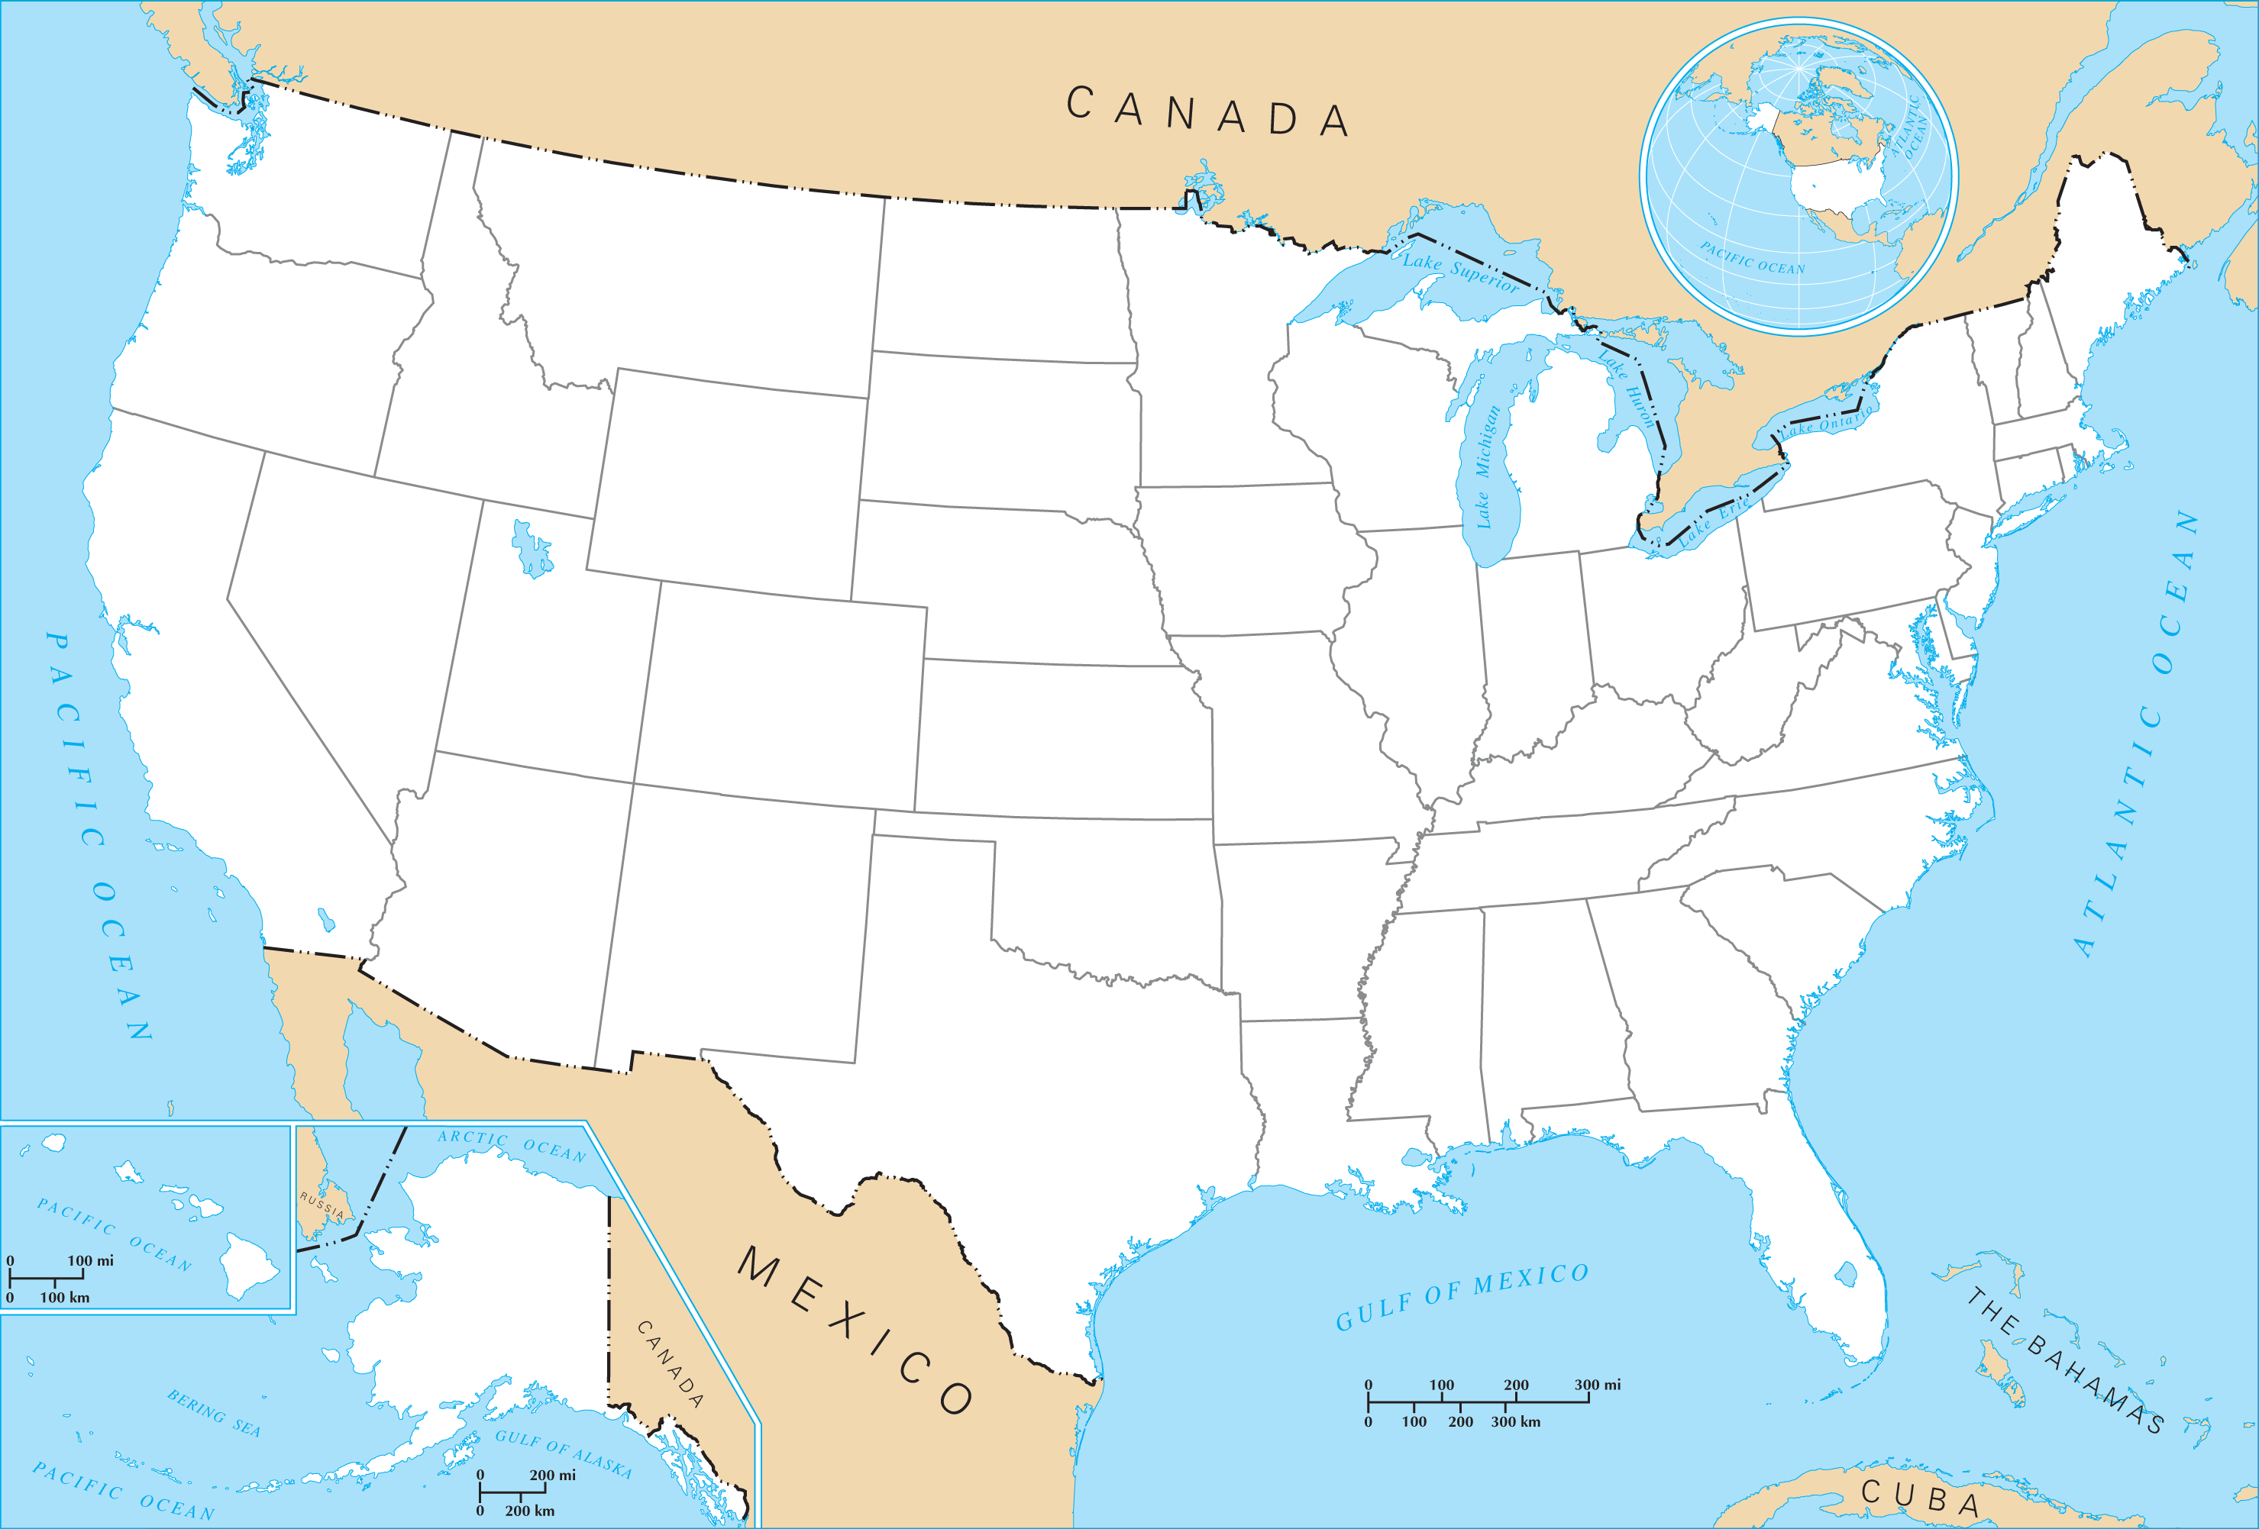
Major North American 2-Wheel INC’s Sales Clusters Rollup Country Overview
WA
OR
West Coast :
55% of Total Revenue while serving 95% of customer base
CA
#1 State: California
- 34% of Total Revenue for 55% of distinct customers
- Top selling product: #1 Mountain-100 Black, 38 – Bikes
Source: Supriya’s analysis on 2-wheel INC’s data

Slide 5
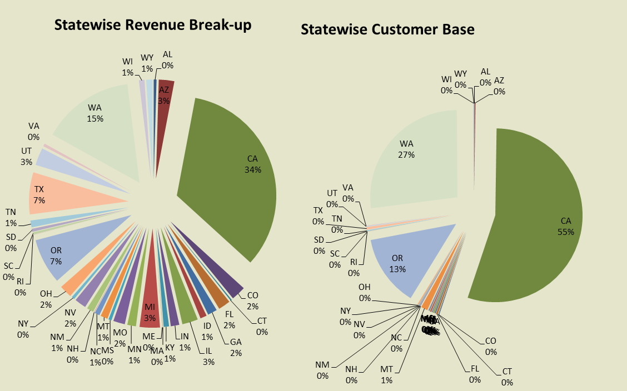
38 US State’s View Pie charts

Slide 6
Our Contact
If you have any questions, you can reach me at:
Supriya.naik@gmail.com
+408-348-4892

